Slide 1
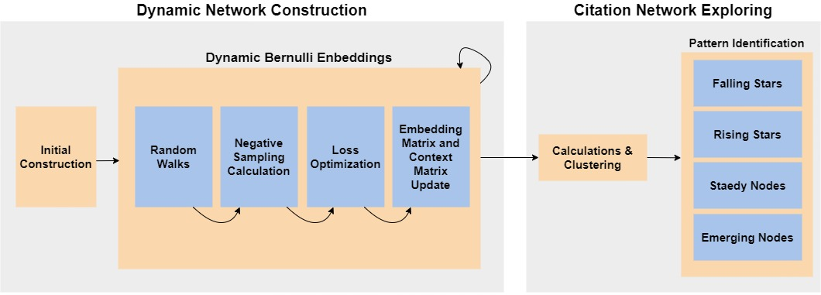
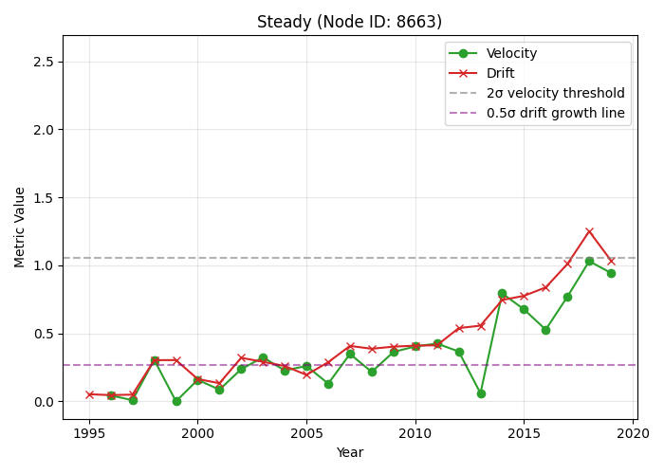
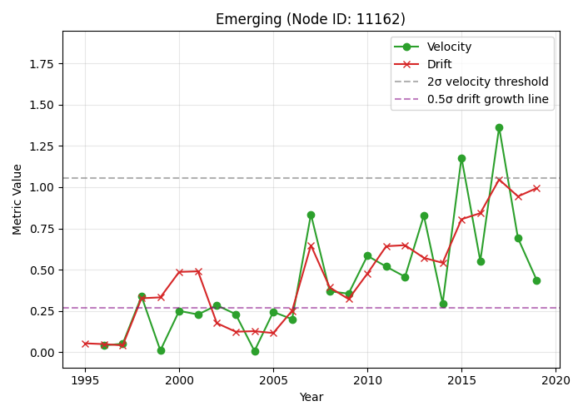
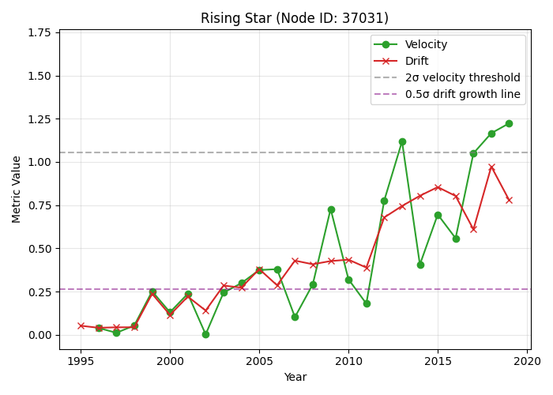
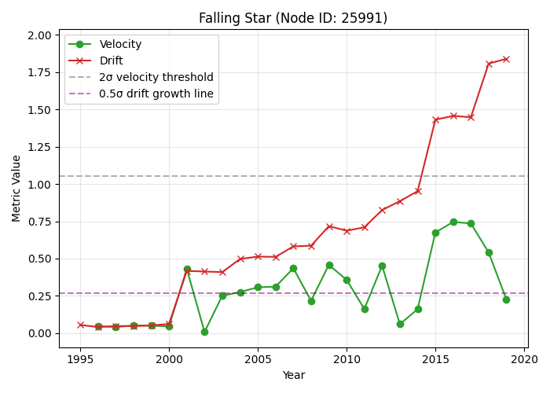
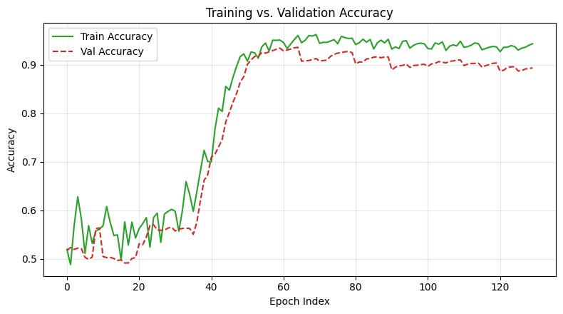
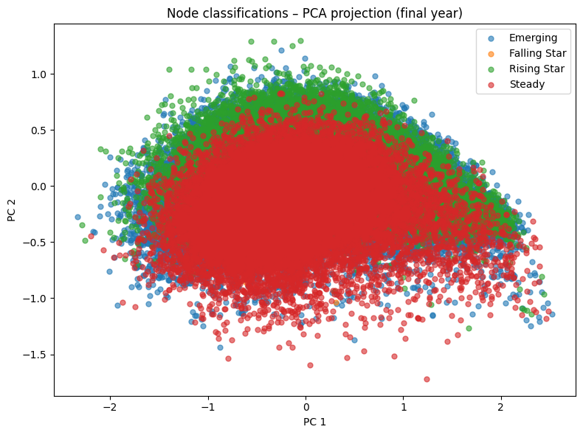
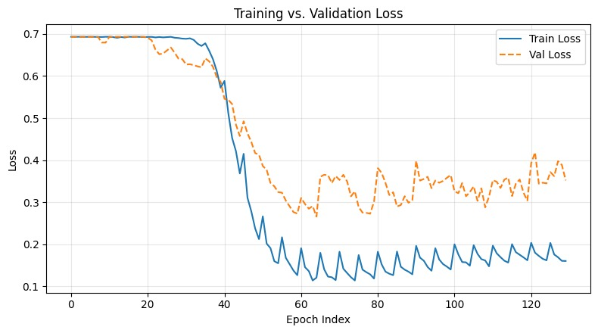


Citation Networks Evolution using Dynamic Network Embeddings
Supervision : Prof. Zeev (Vladimir) Volkovich & Dr. Renata Avros
Students : Avishay Bar & Shay Bistrizky
Research Problem
The influence of scientific papers varies over time in non-uniform and dynamic ways. This temporal behaviour complicates the task of paper characterization when using static models. A time-aware representation is necessary to capture the evolving citation patterns and structural changes within the network.
work part-time while attending school
Model Overview
Node Classification
Emerging Nodes Nodes with recently increasing citations.
Rising Stars Emerging nodes with significant growth.
Steady Nodes Nodes with consistent citation activity.
Falling Stars Nodes with declining citation activity.
Node Identification
All graphs show the temporal evolution of different nodes in terms of velocity and drift, alongside global thresholds (2σ for velocity and 0.5σ for drift). These thresholds help identify distinct behavioural patterns.
$$v_{i}^{\text{center}}\left(t\right)=\frac{1}{N}\sum_{j∈\text{cluster}}{v_{j}\left(t\right)}$$
$${gravity}_{i}\left(t\right)=v_{i}^{\text{center}}\left(t\right)−v_{i}\left(t\right)$$
$$Δv_{i}=∥v_{i}\left(t+Δt\right)−v_{i}\left(t\right)∥$$
Results

